Slide 1

Stochastic Models: Markov Processes
MTH 564 – Mathematical Modeling

Slide 2
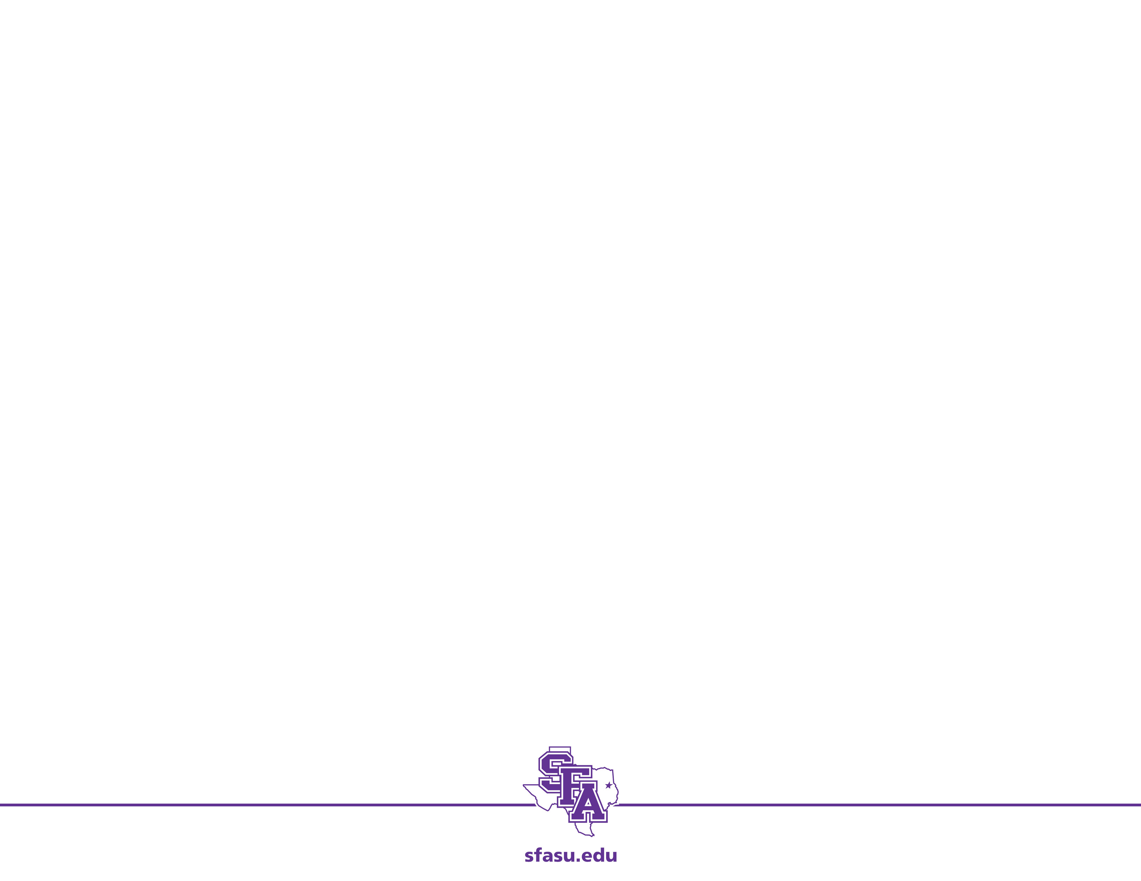
Markov Process
Continuous time stochastic model
Analog of the Markov Chain
Generalizes the continuous time dynamical system models
We only study models with a finite set of states
The key property is: The current state represents the entire state of the system.
The time until the next transition does not depend on how long the process has been in the current state.
The distribution of time spent in a particular state has a memoryless property

Slide 3
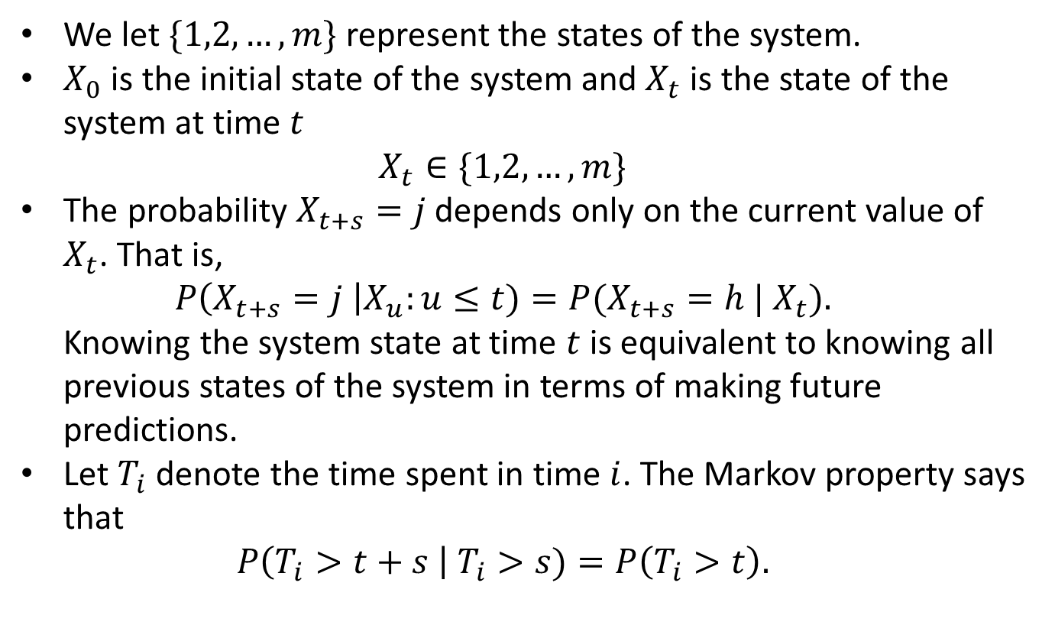
Markov Processes
We let $\{1,2,…, m\}$ represent the states of the system.
$X_{0}$ is the initial state of the system and $X_{t}$ is the state of the system at time $t$ $X_{t}∈\{1,2,…,m\}$
The probability$X_{t+s}=j$ depends only on the current value of $X_{t}$. That is, $P\left(X_{t+s}=j \right|X_{u}:u≤t)=P(X_{t+s}=h | X_{t}).$ Knowing the system state at time $t$ is equivalent to knowing all previous states of the system in terms of making future predictions.
Let $T_{i}$ denote the time spent in time $i$. The Markov property says that $P\left(T_{i}>t+s \right| T_{i}>s)=P\left(T_{i}>t\right).$

Slide 4
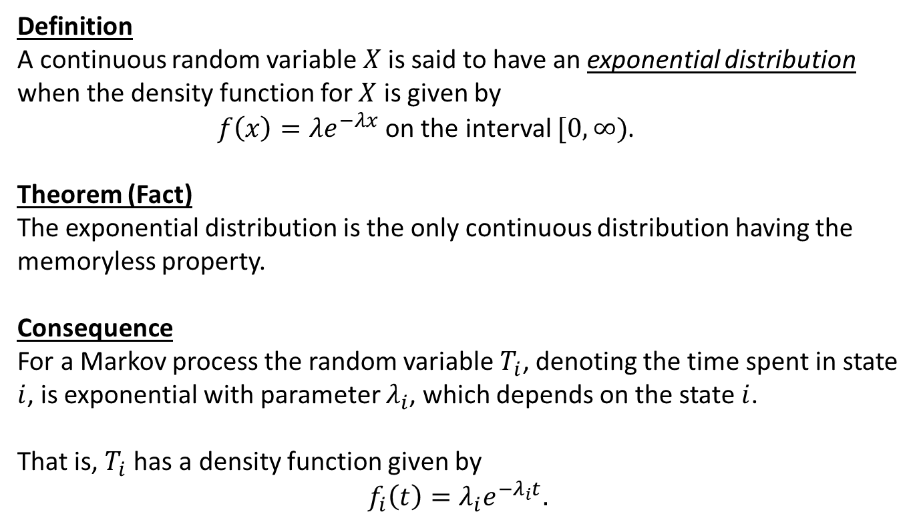
Markov Processes: Theory
Definition
A continuous random variable $X$is said to have an exponential distribution when the density function for $X$ is given by
$f\left(x\right)=λe^{−λx}$ on the interval $[0,∞)$.
Theorem (Fact)
The exponential distribution is the only continuous distribution having the memoryless property.
Consequence
For a Markov process the random variable $T_{i}$, denoting the time spent in state $i$, is exponential with parameter $λ_{i}$, which depends on the state $i$.
That is, $T_{i}$ has a density function given by
$$f_{i}\left(t\right)=λ_{i}e^{−λ_{i}t}.$$

Slide 5
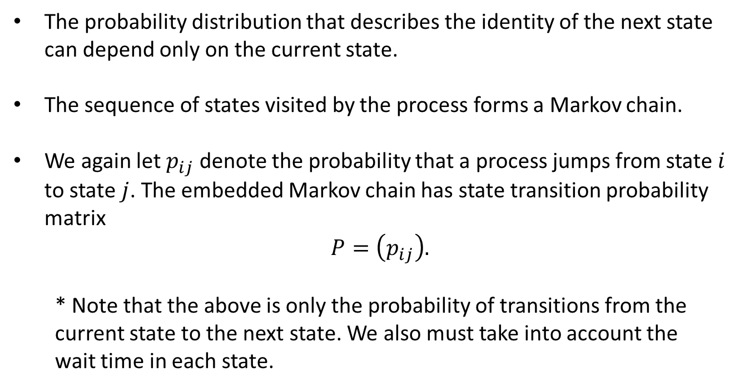
Markov Processes: State Transition
The probability distribution that describes the identity of the next state can depend only on the current state.
The sequence of states visited by the process forms a Markov chain.
We again let $p_{ij}$ denote the probability that a process jumps from state $i$ to state $j$. The embedded Markov chain has state transition probability matrix
$$P=\left(p_{ij}\right).$$
* Note that the above is only the probability of transitions from the current state to the next state. We also must take into account the wait time in each state.

Slide 6
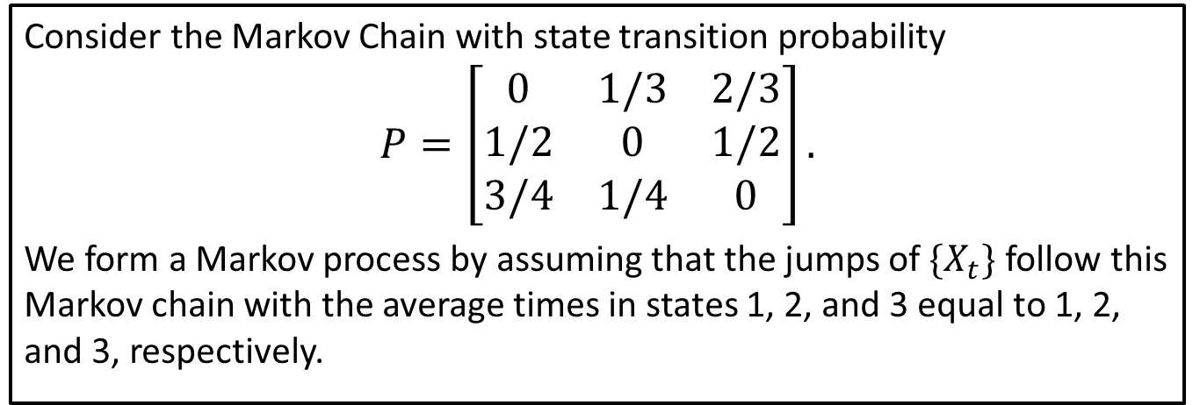
Example
Consider the Markov Chain with state transition probability
$$P=\left[\begin{matrix}0 & 1/3 & 2/3 \\ 1/2 & 0 & 1/2 \\ 3/4 & 1/4 & 0\end{matrix}\right].$$
We form a Markov process by assuming that the jumps of $\{X_{t}\}$ follow this Markov chain with the average times in states 1, 2, and 3 equal to 1, 2, and 3, respectively.
Solving the steady-state equation for $P$ shows that
$$π=\left(0.396, 0.227, 0.377\right).$$

Slide 7
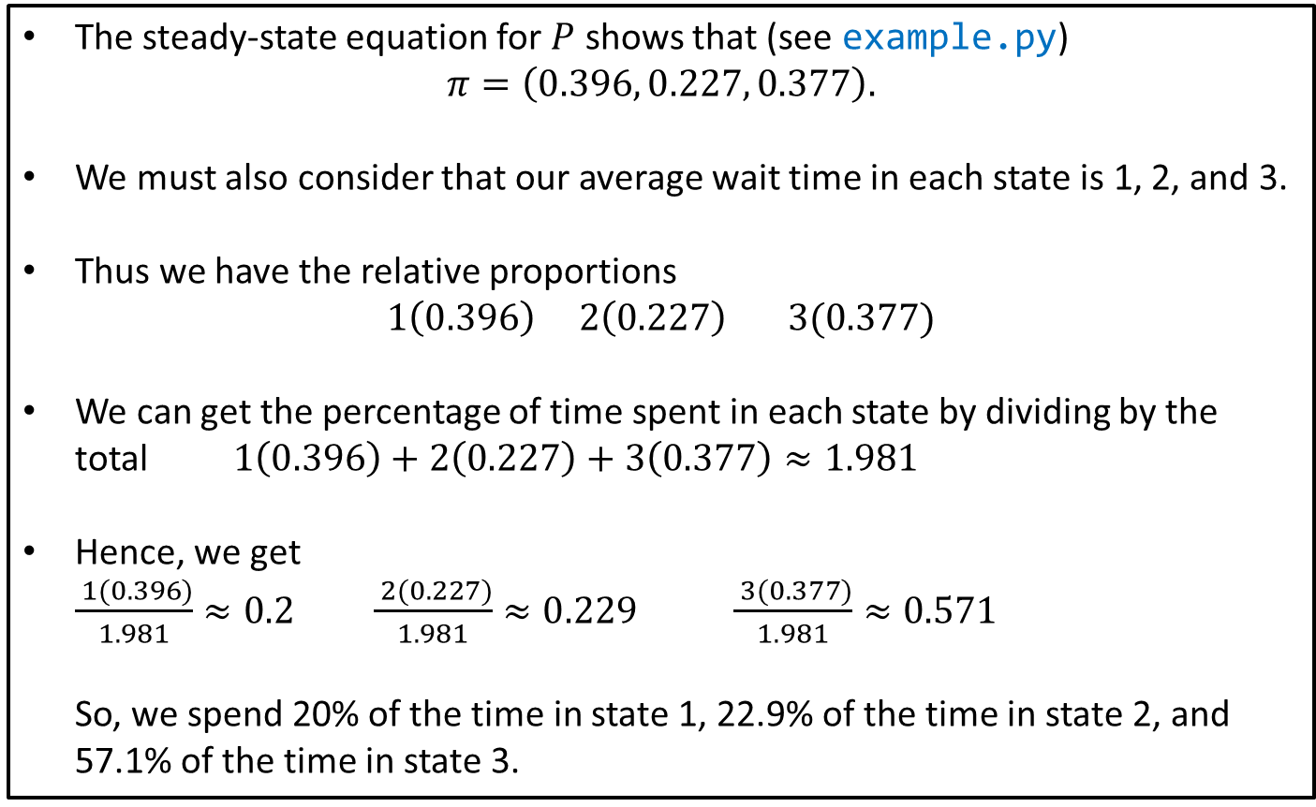
Example
The steady-state equation for $P$ shows that (see example.py)
$$π=\left(0.396, 0.227, 0.377\right).$$
We must also consider that our average wait time in each state is 1, 2, and 3.
Thus we have the relative proportions
$$1\left(0.396\right) 2\left(0.227\right) 3(0.377)$$
We can get the percentage of time spent in each state by dividing by the total $1\left(0.396\right)+2\left(0.227\right)+3\left(0.377\right)≈1.981$
Hence, we get $\frac{ 1(0.396)}{1.981}≈0.2$ $\frac{ 2(0.227)}{1.981}≈0.229$ $\frac{ 3(0.377)}{1.981}≈0.571$ So, we spend 20% of the time in state 1, 22.9% of the time in state 2, and 57.1% of the time in state 3.

Slide 8
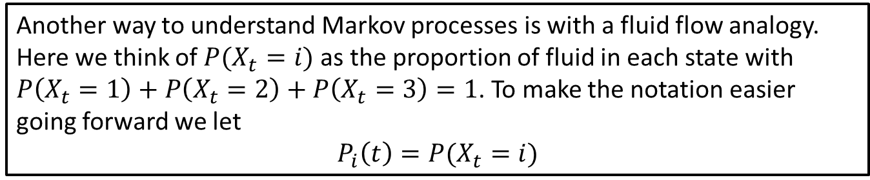
Example: Fluid Flow
Consider the Markov Chain with state transition probability
$$P=\left[\begin{matrix}0 & 1/3 & 2/3 \\ 1/2 & 0 & 1/2 \\ 3/4 & 1/4 & 0\end{matrix}\right].$$
We form a Markov process by assuming that the jumps of $\{X_{t}\}$ follow this Markov chain with the average times in states 1, 2, and 3 equal to 1, 2, and 3, respectively.
Another way to understand Markov processes is with a fluid flow analogy. Here we think of $P(X_{t}=i)$ as the proportion of fluid in each state with $P\left(X_{t}=1\right)+P\left(X_{t}=2\right)+P\left(X_{t}=3\right)=1$. To make the notation easier going forward we let
$$P_{i}\left(t\right)=P(X_{t}=i)$$

Slide 9
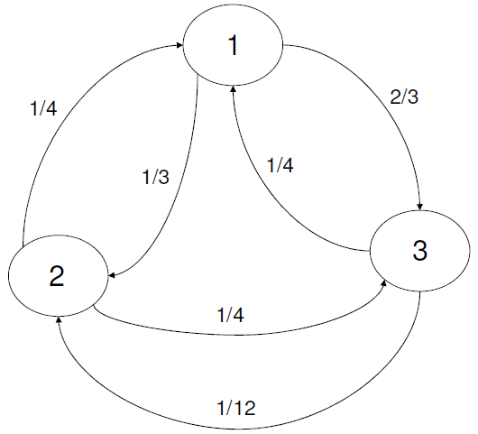
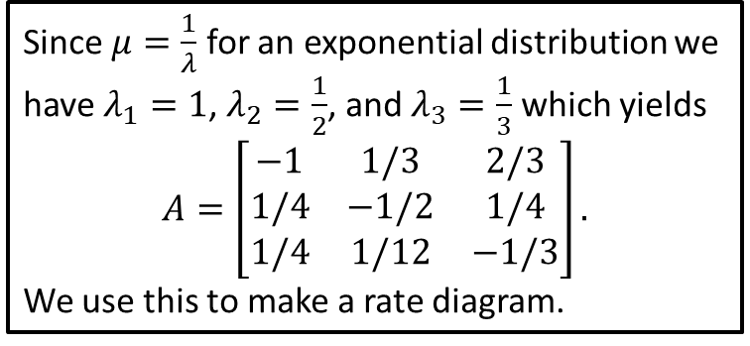
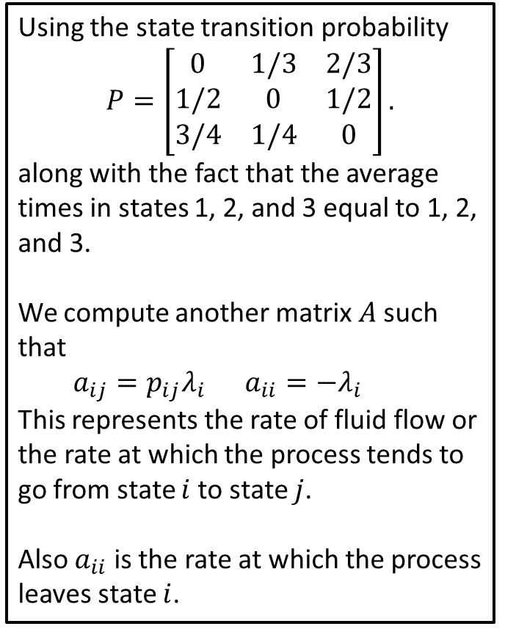
Iteration
Using the state transition probability
$$P=\left[\begin{matrix}0 & 1/3 & 2/3 \\ 1/2 & 0 & 1/2 \\ 3/4 & 1/4 & 0\end{matrix}\right].$$
along with the fact that the average times in states 1, 2, and 3 equal to 1, 2, and 3.
We compute another matrix $A$ such that
$a_{ij}=p_{ij}λ_{i}$ $a_{ii}=−λ_{i}$
This represents the rate of fluid flow or the rate at which the process tends to go from state $i$ to state $j$.
Also $a_{ii}$ is the rate at which the process leaves state $i$.
Since $μ=\frac{1}{λ}$ for an exponential distribution we have $λ_{1}=1$, $λ_{2}=\frac{1}{2}$, and $λ_{3}=\frac{1}{3}$ which yields
$$A=\left[\begin{matrix}−1 & 1/3 & 2/3 \\ 1/4 & −1/2 & 1/4 \\ 1/4 & 1/12 & −1/3\end{matrix}\right].$$
We use this to make a rate diagram.

Slide 10
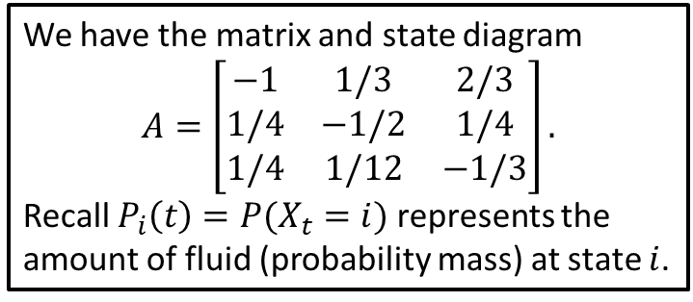
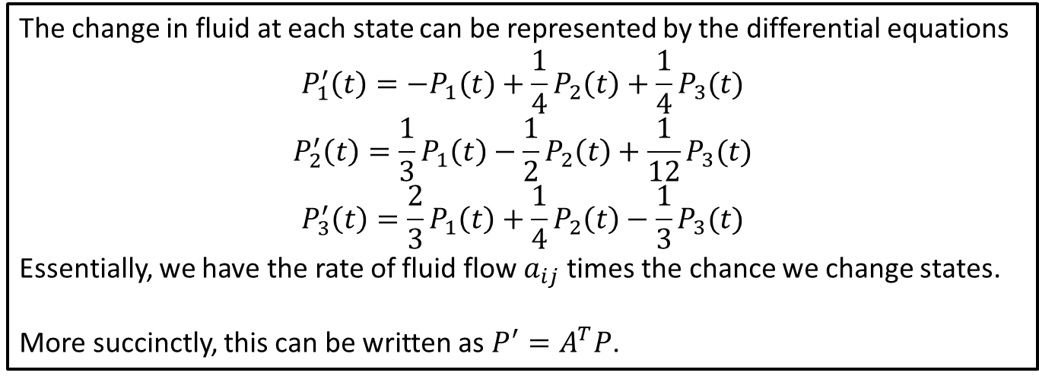
Dynamical System
We have the matrix and state diagram
$$A=\left[\begin{matrix}−1 & 1/3 & 2/3 \\ 1/4 & −1/2 & 1/4 \\ 1/4 & 1/12 & −1/3\end{matrix}\right].$$
Recall $P_{i}\left(t\right)=P(X_{t}=i)$ represents the amount of fluid (probability mass) at state $i$.
The change in fluid at each state can be represented by the differential equations
$$P_{1}^{′}\left(t\right)=−P_{1}\left(t\right)+\frac{1}{4}P_{2}\left(t\right)+\frac{1}{4}P_{3}(t)$$
$$P_{2}^{′}\left(t\right)=\frac{1}{3}P_{1}\left(t\right)−\frac{1}{2}P_{2}\left(t\right)+\frac{1}{12}P_{3}(t)$$
$$P_{3}^{′}\left(t\right)=\frac{2}{3}P_{1}\left(t\right)+\frac{1}{4}P_{2}\left(t\right)−\frac{1}{3}P_{3}(t)$$
Essentially, we have the rate of fluid flow $a_{ij}$ times the chance we change states.
More succinctly, this can be written as $P^{′}=A^{T}P$.

Slide 11
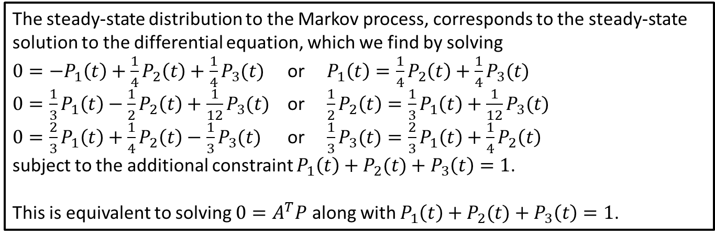
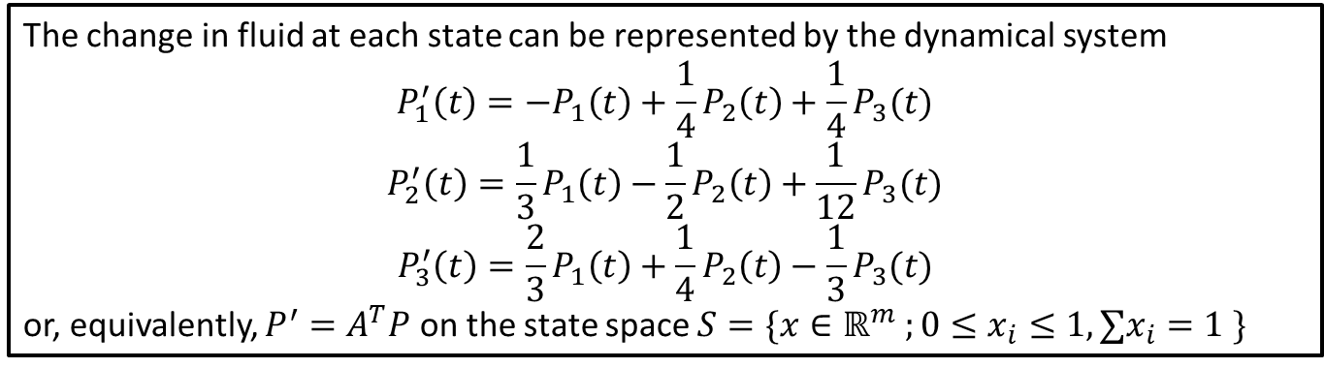
Dynamical System Approach
The change in fluid at each state can be represented by the dynamical system
$$P_{1}^{′}\left(t\right)=−P_{1}\left(t\right)+\frac{1}{4}P_{2}\left(t\right)+\frac{1}{4}P_{3}(t)$$
$$P_{2}^{′}\left(t\right)=\frac{1}{3}P_{1}\left(t\right)−\frac{1}{2}P_{2}\left(t\right)+\frac{1}{12}P_{3}(t)$$
$$P_{3}^{′}\left(t\right)=\frac{2}{3}P_{1}\left(t\right)+\frac{1}{4}P_{2}\left(t\right)−\frac{1}{3}P_{3}(t)$$
or, equivalently, $P^{′}=A^{T}P$ on the state space $S=\{x∈ℝ^{m} ;0≤x_{i}≤1, ∑x_{i}=1 \}$
These can be thought of as
[Rate Out] = [Rate In]
The steady-state distribution to the Markov process, corresponds to the steady-state solution to the differential equation, which we find by solving
$0=−P_{1}\left(t\right)+\frac{1}{4}P_{2}\left(t\right)+\frac{1}{4}P_{3}(t)$ or $P_{1}\left(t\right)=\frac{1}{4}P_{2}\left(t\right)+\frac{1}{4}P_{3}(t)$
$0=\frac{1}{3}P_{1}\left(t\right)−\frac{1}{2}P_{2}\left(t\right)+\frac{1}{12}P_{3}(t)$ or $\frac{1}{2}P_{2}\left(t\right)=\frac{1}{3}P_{1}\left(t\right)+\frac{1}{12}P_{3}(t)$
$0=\frac{2}{3}P_{1}\left(t\right)+\frac{1}{4}P_{2}\left(t\right)−\frac{1}{3}P_{3}(t)$ or $\frac{1}{3}P_{3}(t)=\frac{2}{3}P_{1}\left(t\right)+\frac{1}{4}P_{2}\left(t\right)$
subject to the additional constraint $P_{1}\left(t\right)+P_{2}(t)+P_{3}\left(t\right)=1$.
This is equivalent to solving $0=A^{T}P$ along with $P_{1}\left(t\right)+P_{2}(t)+P_{3}\left(t\right)=1$.

Slide 12
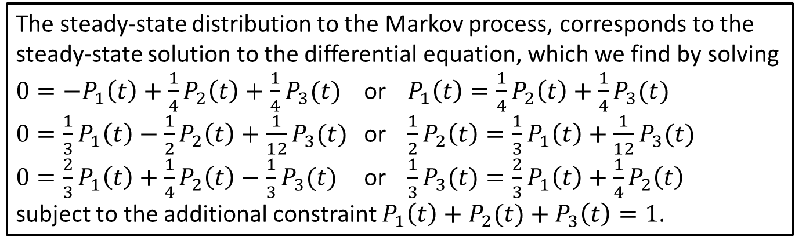
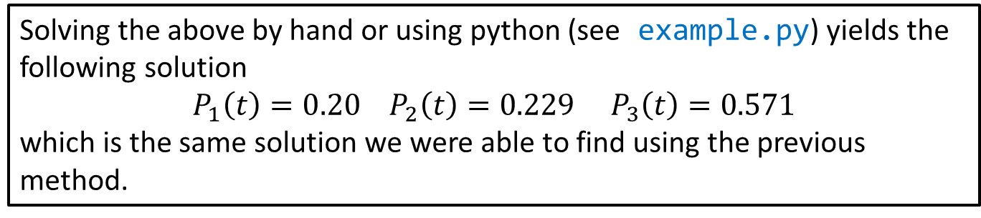
Dynamical System Approach
The steady-state distribution to the Markov process, corresponds to the steady-state solution to the differential equation, which we find by solving
$0=−P_{1}\left(t\right)+\frac{1}{4}P_{2}\left(t\right)+\frac{1}{4}P_{3}(t)$ or $P_{1}\left(t\right)=\frac{1}{4}P_{2}\left(t\right)+\frac{1}{4}P_{3}(t)$
$0=\frac{1}{3}P_{1}\left(t\right)−\frac{1}{2}P_{2}\left(t\right)+\frac{1}{12}P_{3}(t)$ or $\frac{1}{2}P_{2}\left(t\right)=\frac{1}{3}P_{1}\left(t\right)+\frac{1}{12}P_{3}(t)$
$0=\frac{2}{3}P_{1}\left(t\right)+\frac{1}{4}P_{2}\left(t\right)−\frac{1}{3}P_{3}(t)$ or $\frac{1}{3}P_{3}(t)=\frac{2}{3}P_{1}\left(t\right)+\frac{1}{4}P_{2}\left(t\right)$
subject to the additional constraint $P_{1}\left(t\right)+P_{2}(t)+P_{3}\left(t\right)=1$.
Solving the above by hand or using python (see example.py) yields the following solution
$$P_{1}\left(t\right)=0.20 P_{2}\left(t\right)=0.229 P_{3}\left(t\right)=0.571$$
which is the same solution we were able to find using the previous method.

